Slide 1
ICS State of the School: 2016-2017
International Community School
September 29, 2016

Slide 2
ICS Text Messages
Search for text message from 67587
Reply Y
If you do not see the message, fill out text card

Slide 3
Agenda
ICS History
ICS Today
ICS Strategic Plan
Questions

Slide 4
ICS Vision and Mission
Vision
The International Community School seeks staff and families who are committed to our vision of creating a supportive community of students, staff and parents, learning from each other and celebrating diversity among us.
Mission
The International Community School is an International Baccalaureate World School that educates refugees, immigrants and local children, and provides a rigorous and holistic education in an intentionally diverse community of mutual learners.

Slide 5
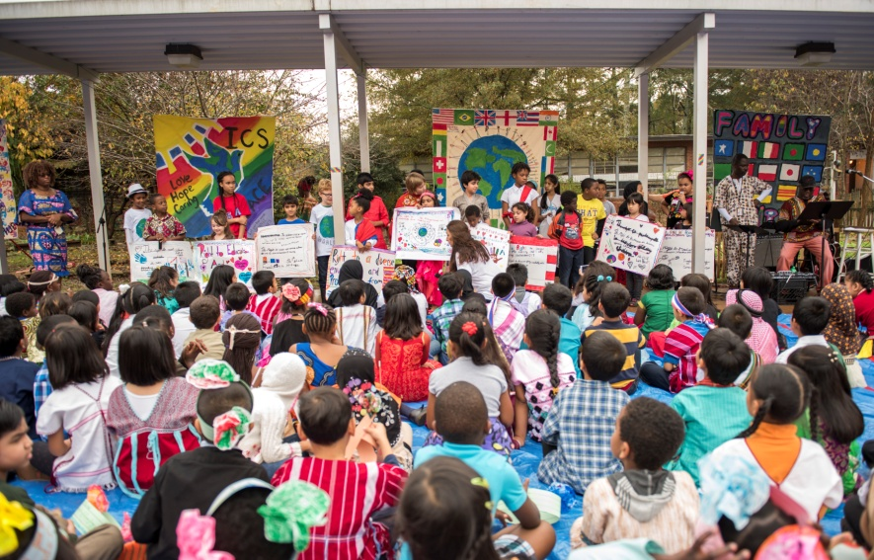
ICS History

Slide 6
ICS Today
ICS continues to carry out our mission every single day
Velde-Cabrera is here to stay
Visibility
Processes for teachers and staff to increase communication internally and externally
More structure and calm school culture
Renewed and increased focus on academic instruction
Development effort

Slide 7
Strategic Plan
Strategic Direction 1: Educational Approach
Strategic Direction 2: ICS Culture
Strategic Direction 3: Development
Strategic Direction 4: Human Resources
Strategic Direction 5: Communication
Strategic Direction 6: Operations

Slide 8
Strategic Direction 1: Educational Approach
Range of levels on MAP Testing
Focus on differentiated instruction
Literacy focus
Writing workshops in Spring 2017
Balanced Literacy training for all teachers in Spring 2018
Math and science focus
Students grow one year on MAP Test
Get involved: Teaching and Learning Committee meets first Tuesday of every month (contact Chad Velde-Cabrera, Rhina Williams or Jon Schmidt-Davis to get involved) Ask your teachers about MAP data at conferences.

Slide 9
Strategic Direction 2: ICS Culture
"Advancing a shared, inclusive, and diverse ICS culture.”
Provide training and workshops for staff and Board members on the concept of Beloved Community
Create an ICS 101 Educational Program for new teachers, students, families, board members, and sponsors
Get Involved:
Contact: Anne Phillips
Contact Info: Anne.Phillips@icsgeorgia.org
Notes:
"Advancing a shared, inclusive, and diverse ICS culture."
Preserve and strengthen the ICS culture bIdentify additional opportunities for community interaction, including additional communication avenues, workshops, gatherings, and meetings
Create additional exposure within the ICS community for what makes ICS unique and special
Communicate the ICS philosophy, our terms of engagement, and process for school-wide conflict resolution through training for staff, administration, board members, and parents.
Provide training and workshops for staff and Board members on the concept of Beloved Community
Create an ICS 101 Educational Program for new teachers, students, families, board members, and sponsors

Slide 10
Development vs. Funding
Development = Relational
Building, over time, a continuous, powerful and life-long connection between a donor / philanthropist and the organization or cause we represent.
Extended cultivation, thorough education, attentive stewardship, & appropriate solicitation

Slide 11
Development vs. Fundraising
Fundraising = Transactional
Focus is on solicitation.
An organization with a specific and short-term financial goal asks for a one-time, (usually modest) gift (usually money) from a donor, usually for a specific cause or project.

Slide 12
Development vs. Fundraising
"Fundraising" and "Development" also work together.
Every fundraising transaction is the first step in building for the future.
Fundraising activity is essential as we seek to meet our annual fundraising goals and budget pressures.

Slide 13
501(c)3….
Remember that ICS is a NON-PROFIT!
We are not exclusively funded by county tax dollars.
We need fundraising to be done by the Board of Directors, Parents, IPTSO, Sponsors, Donors, Faculty, and the Greater ICS Community.

Slide 15
Strategic Direction 3: Year 1
“PLAN”: Set the money we have and find the money we want
“PLANT”: Set our purpose in the community and engage community partners
“GROW”: Build our future IN the community & WITH our community
Get Involved:
Volunteer!
Use passive fundraising (Kroger, Amazon, etc.)! – EASY MONEY
Nov 4, 2016 – GA Gives Day – EASY MONEY
Talk up ICS to your neighbors and local businesses
ASK QUESTIONS!
Know any grant writers?
Support your teachers!
Notes:
Ensure we have enough cash
Improve how we manage our budget
Keep our strong credit rating
Continue to diversify under the mission
Create a 3-year roadmap
Re-engage past donors and friends
Build a grant writing team
Clean up our processes
Culivate community relationships based on our mission
Hire a Development Officer

Slide 16
Strategic Direction 4: Human Resources
“Building talent and support for the future.”
Are we doing our best to recruit, develop, reward, organize, and retain talent?
Big focus on the employee life cycle and volunteer capital
Year One action items – job descriptions, development plans, and compensation
Let’s work together to make ICS an employer of choice!

Slide 17
Strategic Direction 5: Communication
All Stakeholders: “Better communication is essential”
Current and ongoing improvements
Strategic Direction 5 looks to change the communications system
Get involved: jill.hennecy@icsgeorgia.org
Notes:
All Stakehoders: “Better communication is essential”
Board to parents, board to faculty, administration to parents, administration to faculty, teachers to teachers, ICS to prospective parents, ICS to donors. (External and Internal)
Consistent access to translation is key to our mission
Current improvements: Claudia is half-time communications coordinator and is doing fabulous work. Bi-weekly newsletter. Front office has implemented better communication technology: Robo Calls, Texts.
Strategic Direction 5 tackles all these with a focus on creating policies and procedures to ensure system is in place and followed and a special emphasis on creating a sustainable system for consistent translation.

Slide 18
Strategic Direction 6: Operations that reflect ICS mission and maximize efficiency
Technology
Assess needs and respond with improved access to high-quality technology
Busing
Initiate conversations with DeKalb County School District to find support for county busing
Building and Grounds
Evaluate long-term needs for facility and site
Identify and pursue programs that yield energy-efficient outcomes for facility
Upgrade to hardier turf field and new playground structures

Slide 19
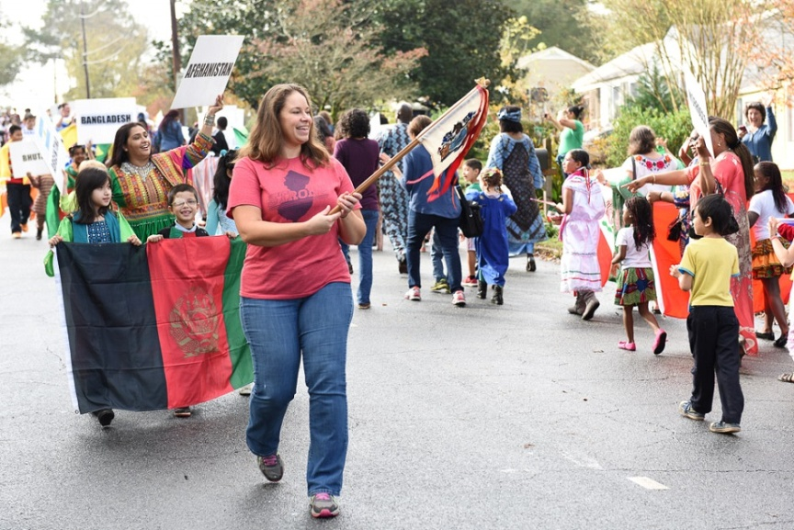
Questions?

